Slide 1


2W1C
Elena Nicolas Yasin
BICYCLE SAFETY ROUTING FOR BERLIN
Capstone project · GIS baseline + Leakage-safe ML + Severity evidence

Slide 2
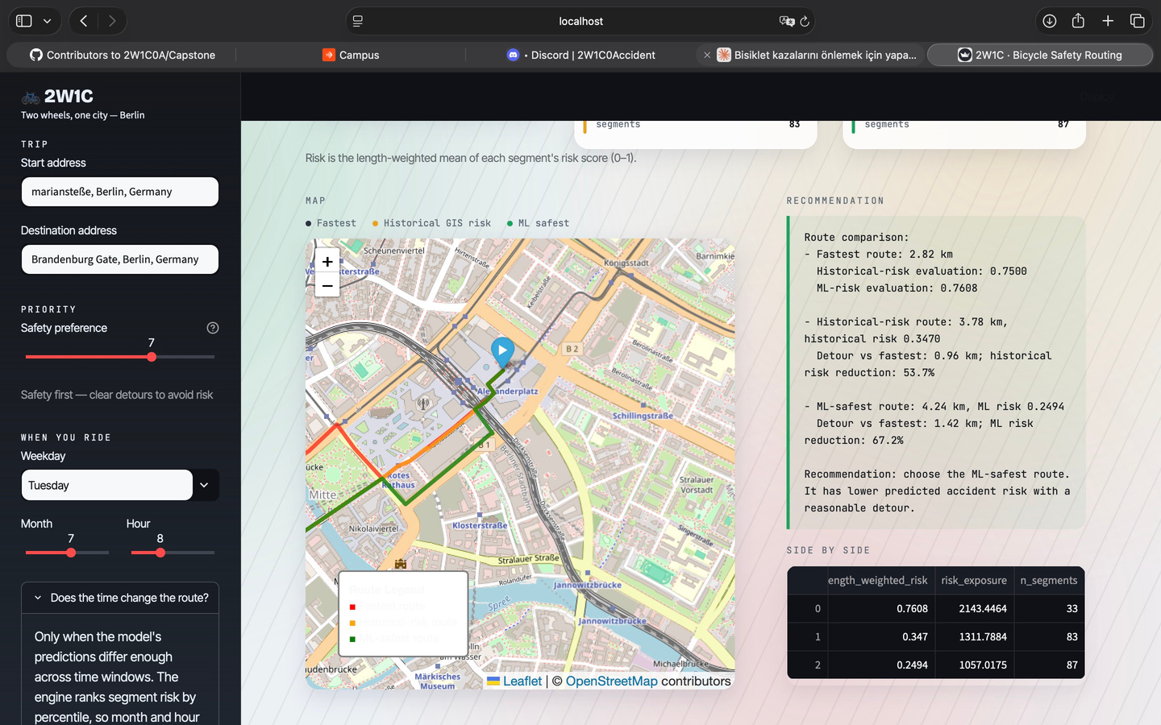
1 · Business Problem And Product
WHAT PROBLEM DOES 2W1C SOLVE?
CYCLIST PAIN POINT
Navigation apps optimize distance and
time very well, but rarely explain route safety.
For a cyclist, the useful question is not
“where will the next crash happen?”
but “which route avoids historically risky street
segments with a reasonable detour?”
PRODUCT PROMISE
2W1C compares three choices:
1. Fastest route
2. Historical GIS-risk route
3. Leakage-safe ML road-
risk route
The output is a map plus
the risk–distance trade-off.
BUSINESS VALUE
For city mobility products, bicycle
insurance, logistics, or public-sector planning, the value is interpretable risk-aware routing.
It is also auditable: the app shows where risk comes from, what the model can prove, and what it cannot prove.
1

Slide 3
1
2
3
4
Unfallatlas
Berlin bicycle
crashes
2018–2025
OpenStreetMap
Bike graph + road
attributes
GIS risk
Snap crashes to
street segments
ML model
Leakage-safe
road-risk model
Historical GIS route
Severity-weighted past
risk + junction risk
ML road-risk route
Road-only, no accident-
derived leakage
Severity evidence
KSI conditional on a crash
8
5
6
7
Limitations
Exposure and Time
effects are explicit
2 · Product Workflow
From Unfallatlas crashes to route recommendation
2

Slide 4
3 · Dataset : Origin, Quality And EDA
Unfallatlas + OpenStreetMap, validated before modelling
CLEAN CRASHES
37,896
SNAPPED TO OSM
MEDIAN OFFSET
NEAR JUNCTION
37,948
0.7
80.8%
Berlin bicycle crashes,
2018–2025
99.9% within 25 m
High coordinate quality
within 20 m of node
Origin
Quality Checks
EDA Lesson
Unfallatlas crash records
Crashes are spatially clustered
25 m snapping threshold
OSM bicycle road graph
Junction Distance calculated
Many are close to intersections
Edge features: road class
length, cycleway, speed, limit
Raw columns kept for severity evidence
Time patterns exist in EDA
3

Slide 5
4 · Baseline model
Historical GIS risk is the auditable product baseline
37,896
routing cost
length × (1 + safety preference × risk) + junction penalty
37,948
Selected baseline
Historical GIS-risk route
Why this baseline?
• transparent
• easy to explain
• works without label leakage
• directly maps past crashes to street segments
• gives a user-visible route comparison
How it works
1. Snap crash points to OSM edges
2. Weight severity
3. Aggregate by undirected street segment
4. Add junction risk
5. Penalize high-risk edges in routing cost
Forward validated
Built on 2018–2023, tested on 2024–25: the riskiest 22% of network length contains 55% of future crashes — 2.56× lift over random.
Product output
59% lower risk exposure for a 0.89 km detour — not “the objectively safest route”.
4

Slide 6
5 · Models and leakage audit
A better product came from diagnosing the too-good model
Model Status PR-AUC Lift Meaning
time_only diagnostic 0.4125 1.00× matches base rate by construction: negatives inherit positive timestamps
road_only DEPLOYED 0.7228 1.76× best leakage-safe product model
road + time diagnostic 0.7049 1.71× time does not improve the road model
leaky INVALID 0.8892 2.16× uses accident-derived columns; not reported as performance
Leakage removed
Every positive had accident_count ≥ 1 by construction; only 7.6% of negatives did. Recall hit exactly 1.000 — the model read the label.
Negative sampling fixed
Negatives restricted to rideable road classes, so the task is not “road versus footpath”.
Honest result
0.72 against a 0.41 base rate. Lower than 0.89, and the only figure we can defend.
5

Slide 7
6 · Metric choice
Why PR-AUC and lift are more useful than accuracy
37,896
Selected metrics
Primary: PR-AUC
Secondary: lift over base rate, top-10% recall, Brier score
Product: forward-validation lift, then risk reduction vs detour
Why PR-AUC?
The positive class is rare and the product is a risk-ranking problem. We care whether high-risk segments appear near the top of the ranking, not just overall accuracy.
What not to use alone
Accuracy can look good even when the model misses risky segments. ROC-AUC is useful, but PR-AUC is more informative when positives are relatively scarce.
37,948
base rate
0.412
road-only
0.723
leaky
0.889
deployed model
invalid
expected PR-AUC with no ranking skill
6

Slide 8
7 · Product demo flow
What the user sees in the app
Start / destination
Address validation
Compare routes
Fastest · Historical GIS · ML road-risk
Output
Map + detour + risk reduction
Decision
Choose trade-off
Fastest route
2.82 km
Highest relative risk in example
Historical-risk route
+0.96 km
53.7% lower historical score
ML road-risk route
+1.42 km
67.2% lower ML score
The percentages are lower model scores, not lower real-world crash probability.
7
Notes:
This slide explains the demo. A user enters a start and destination; the app validates addresses; then it compares route options. I can use an example where the fastest route is shortest, but has higher model risk, while the historical and ML routes require detours but lower the respective risk scores. The most important caveat is that these are relative model scores, not real-world crash probabilities. For the demo, this is also where I explain that the hour slider is kept for transparency but does not currently drive route changes.

Slide 9
8 · Timeline and current status
Week 2 status: working pipeline, stronger validation, clearer risks
Week 1 Data foundation
Problem framing
Unfallatlas EDA
OSM data loading
Week 2 Core product
Full src package + run_pipeline.py
Streamlit app and route engine
Fastest vs historical vs ML routes
Exposure normalisation added
Week 3 Risk ML proof
BASt severity weights + shrinkage
Node/link accidents partitioned
3 algorithms, 5-fold CV
Best PR-AUC: 0.863 vs 0.245
Week 3
Leakage audit
Negative sampling fix
ML comparison
Week 4
Streamlit app
Demo polish
Done
Pipeline + GIS baseline + leakage-safe model + app
Next
Forward validation,
Performance improvement, exposure data
2W1C · Defensible bicycle safety routing
08
Notes:
This slide gives the timeline. Week one was problem framing and basic EDA. Week two was building the GIS baseline. Week three was the important model audit: we found and removed leakage, and fixed negative sampling. Week four is product polish and presentation. Current status: the project has a functioning pipeline and app, the risk baseline is implemented, the ML model is leakage-safe, and the severity evidence is separated from route prediction. The remaining work is mainly demo polish and additional validation.

Slide 10
9 · Future work and difficulties
What would make the prototype stronger and harder to break
Exposure data
App speed
User reports
Add bicycle-volume data to separate risk from traffic volume.
Current routing can take >2 min; cache graph costs and precompute risks.
Let cyclists upload unreported crashes and near misses.
Better ML
Time-aware risk
Validation
Compare more models and ensembles to improve valid PR-AUC.
Use hour as severity modifier only when data supports it.
Test whether past high-risk streets predict future crashes.
Improve the product without overclaiming — route scores are relative model evidence, not real-world crash probabilities.
09
Notes:
The final slide is future work and difficulties. The hardest difficulty is exposure data. Crash counts alone do not tell us whether a road is dangerous or simply heavily used. The second difficulty is time. The current hour slider is transparent but not truly route-changing. A more advanced version would use bicycle volume, traffic mix, truck exposure, and severity weighting. Forward validation is also important: train on past years and test whether the top-risk streets capture future crashes. Finally, the app needs UX improvements such as better address autocomplete, faster routing, and simpler language for real users.

Slide 11
10 · Takeaway
A working prototype, a stronger model story, and a clear civic motivation
What we built
A Berlin bike-routing MVP
Fastest, historical-risk and ML routes
Address validation + demo-ready app
What we learned
Historical risk predicts future crash concentration
Leakage was found and removed
Risk scores are model evidence, not crash probabilities
Outlook
Make the app faster and easier to use
Add user-reported, unreported crashes
Compare and combine more ML models
10
Notes:
Close by saying that the main achievement is not a perfect model; it is a defensible product pipeline. We built the product, found a serious modelling problem, fixed it, and now have a clearer story: GIS baseline, leakage-safe ML, severity evidence, and limitations. This is exactly the kind of discipline a data science product needs before it can be trusted.

Slide 12

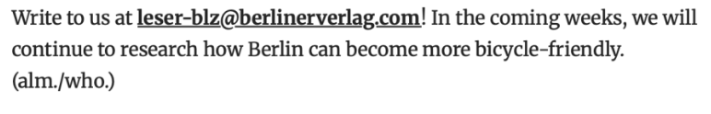
Thank you

